Slide 1

What To Do About Western Wholesale Markets?
August 25, 2000
Tim Belden
Enron North America
West Power

Slide 2
Summary
High prices in peak periods are the result of scarcity and are necessary to incent needed generation investment
California Retail/Wholesale Market Interaction
  Retail customers are benefiting from the low prices during shoulder months caused by wholesale competition
  The major problem is in the retail market where high peak period wholesale prices have not been mitigated by forward purchases
  Underscheduling in forward market causes high demand and reliability problems during real time
-2-

Slide 3
Summary (Continued)
Some wholesale market remedies are necessary now
  The FERC should analyze whether there are Market Power Concerns Associated with Times of Scarcity and then determine appropriate level of Price Caps
  Publicize Market Information
  Encourage structure/ technological innovation to enhance demand side participation

Slide 4
Agenda
Market Fundamentals Indicate Scarcity Exists
Supply Side and Demand Side Economics
Retail Design Issues
Wholesale Market Remedies

Slide 5
Western Supply and Demand Fundamentals
-3-

Slide 6
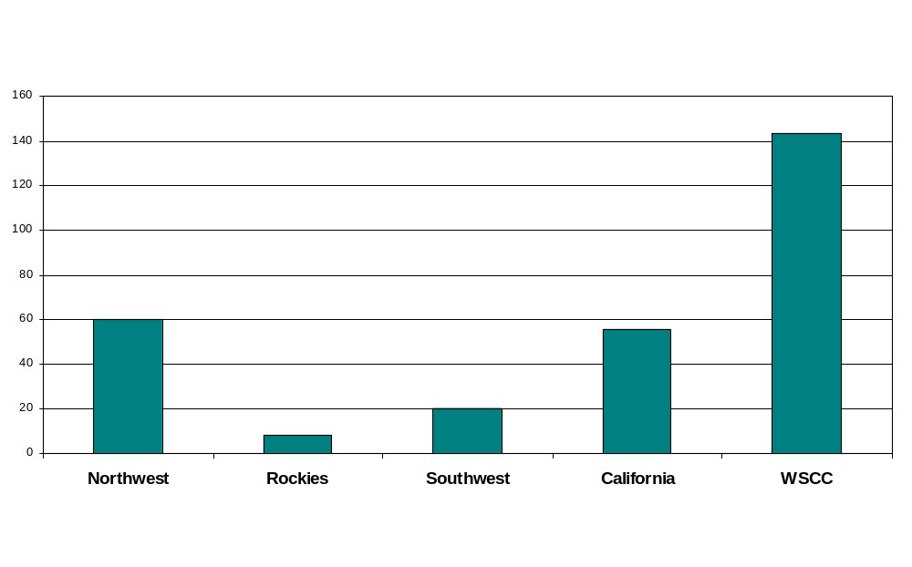
WSCC Loads (GW)
California is not an island and cannot develop a self-contained solution.
5

Slide 7
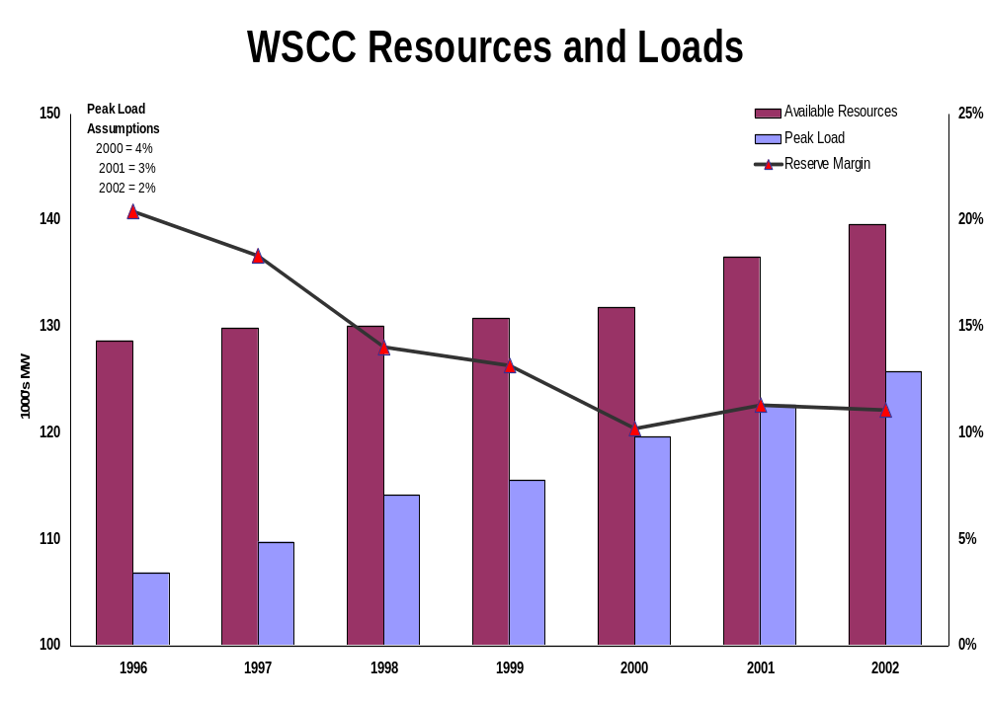
Base data from WSCC. Adjustments made by Enron based on verifiable data inaccuracies.
-11-

Slide 8
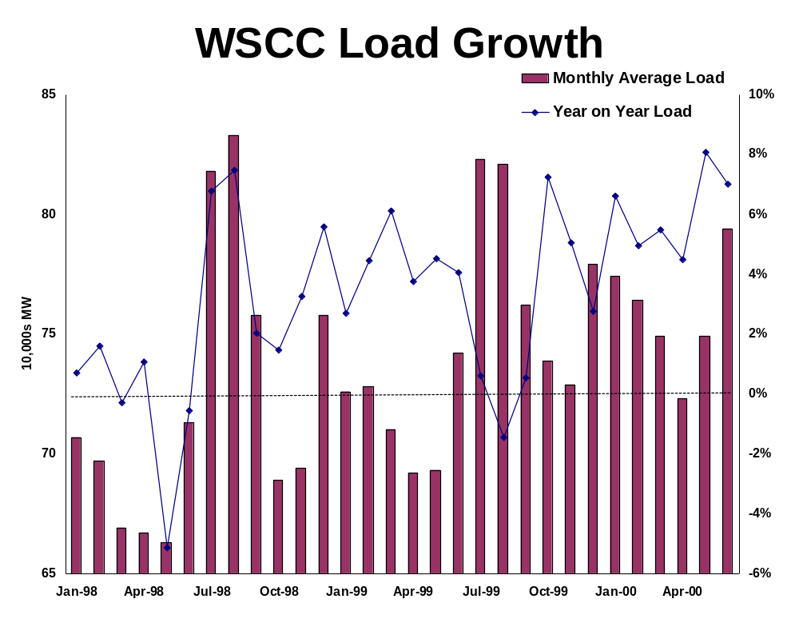
-4-

Slide 9
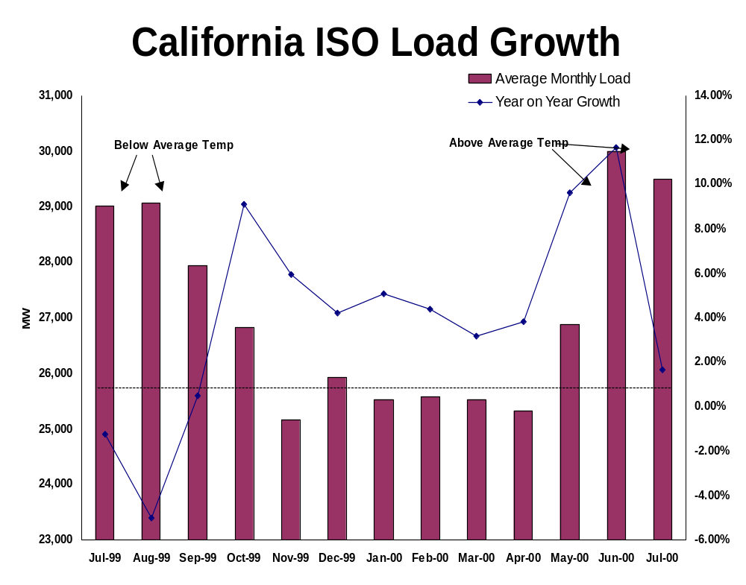
-5-

Slide 10
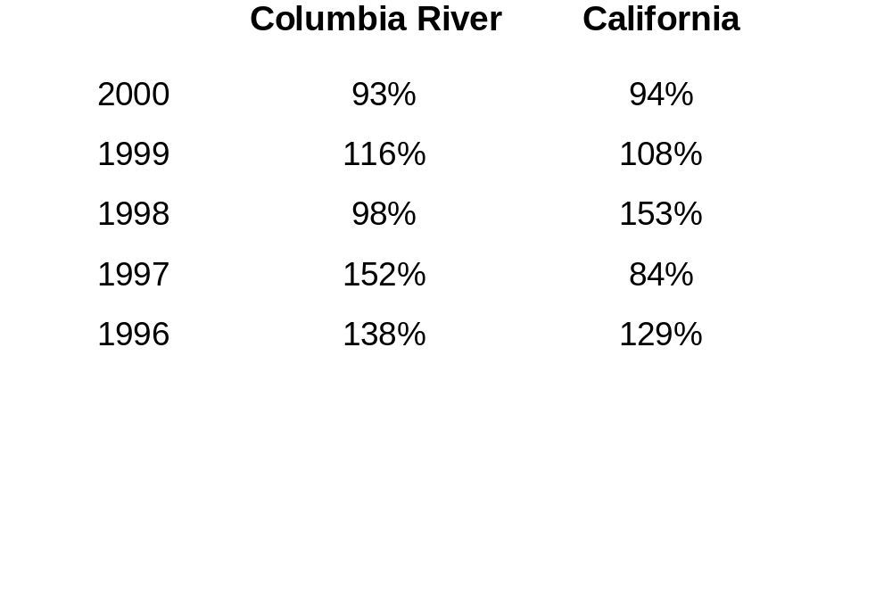
Has Recent Unusually Strong Hydro Fooled Us?
Volume Runoff Percent of Normal
-7-

Slide 11
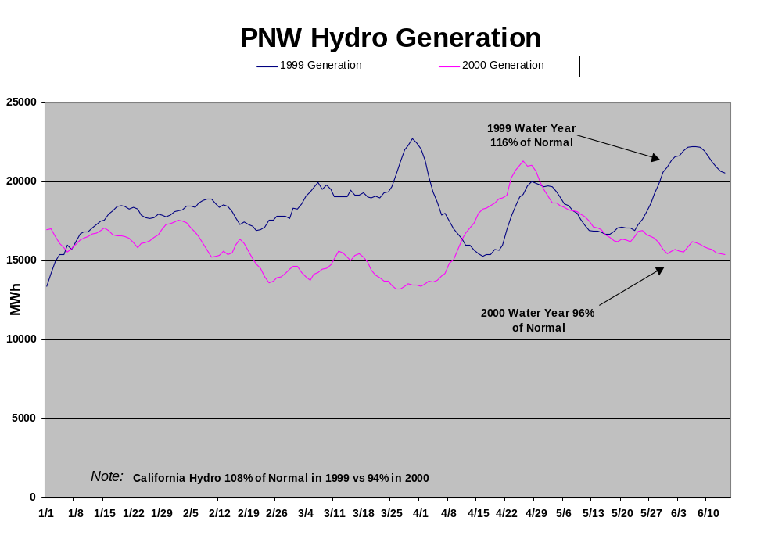
21

Slide 12
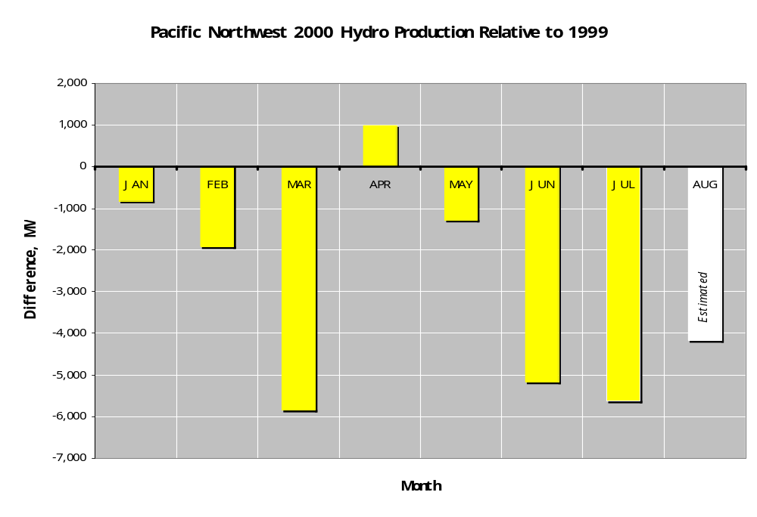
-8-

Slide 13
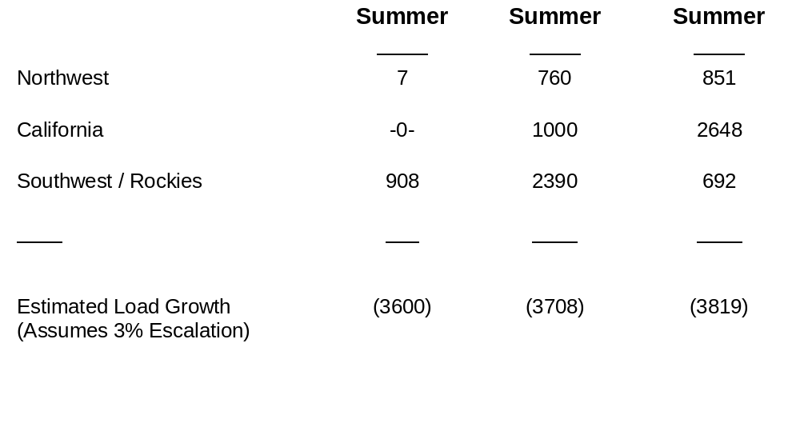
WSCC Capacity Additions
-10-

Slide 14
In Sum, Scarcity is Real - Generation is Needed
Scarcity is real
Energy prices driven by scarcity
New generation or demand-side resources are required
-11-

Slide 15
Current Supply/Demand Economics

Slide 16
Power Economics
Power is a Bust and Boom Commodity -- Merchant Generators Lose Money in Some Years and Make it Up During Times of Scarcity
California Demand Side Resources are Far More Expensive than Supply Side Resources
Demand Side and Supply Side Resources Should Receive Symmetrical Treatment with Respect to Price Signals

Slide 17
Peaker Plant Economics
Technology: GE LM 6000
Fuel: Natural Gas
Heat Rate: 10,000 Btu/Kwh
Capacity: 48 MW
Capital Structure:
  60% Debt @ 9%
  40% Equity @ 18%
  15 Year Amortization
Total Cost to Build: $27 million
Annual Capital Recovery: $3.7 million
Annual Fixed O&M: $1.5 million
Annual Total: $5.2 million
-14-

Slide 18
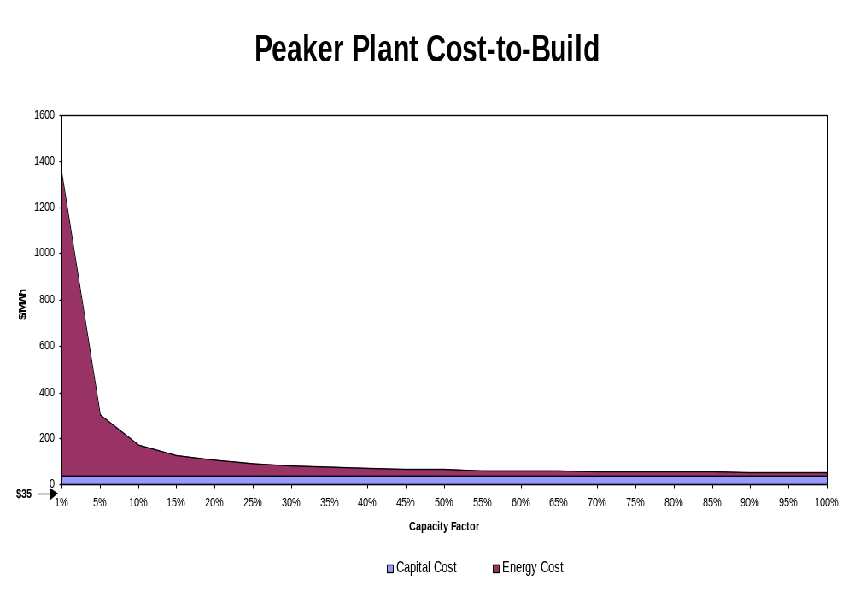

Slide 19
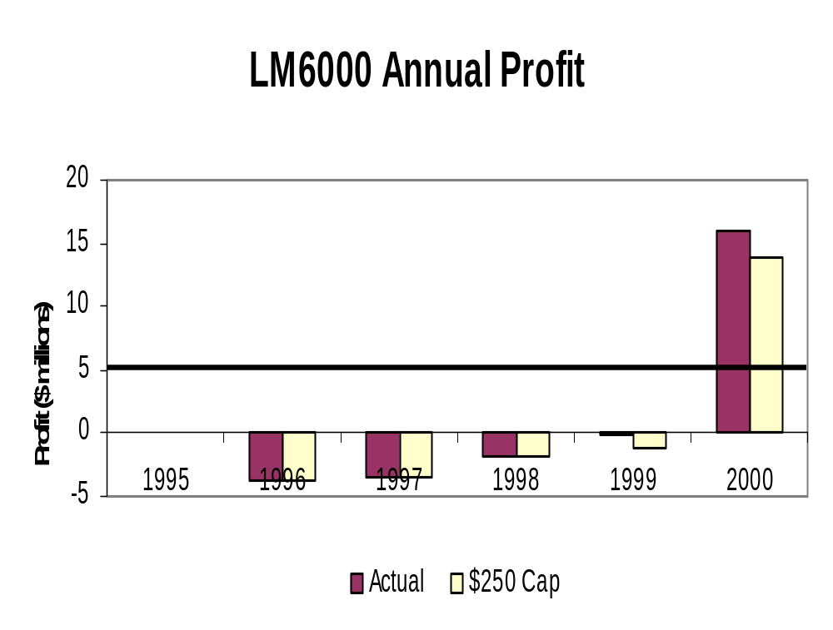
18% ROE
-15-

Slide 20
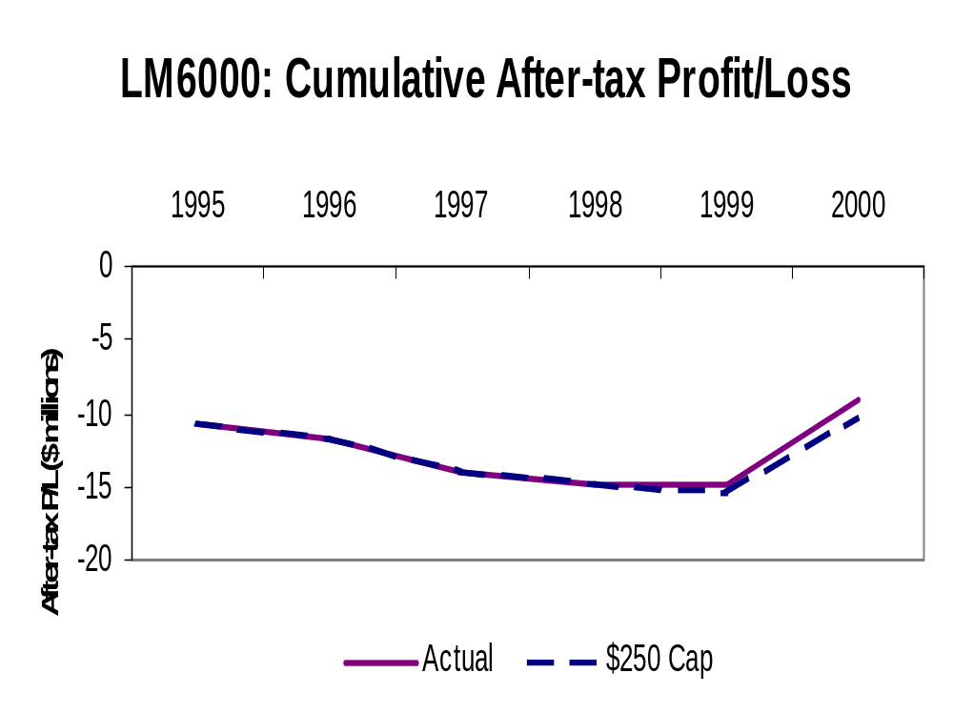
-16-

Slide 21
Baseload Plant Economics
Technology: GE Frame 7FA Combined Cycle
Fuel: Natural Gas
Heat Rate: 7,100 Btu/Kwh
Capacity: 280 MW
Capital Structure:
  50% Debt @ 9%
  50% Equity @ 15%
  15 Year Amortization
Total Cost to Build: $180 million
Annual Capital Recovery: 24 million
Annual Fixed O&M: 3 million
Annual Total: $27 million
-17-

Slide 22
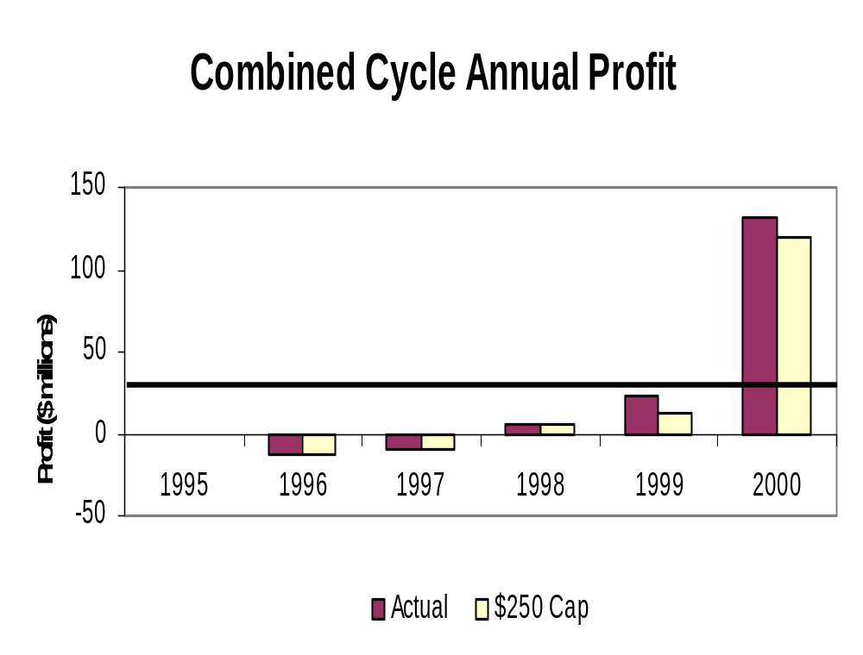
15% ROE
-18-

Slide 23
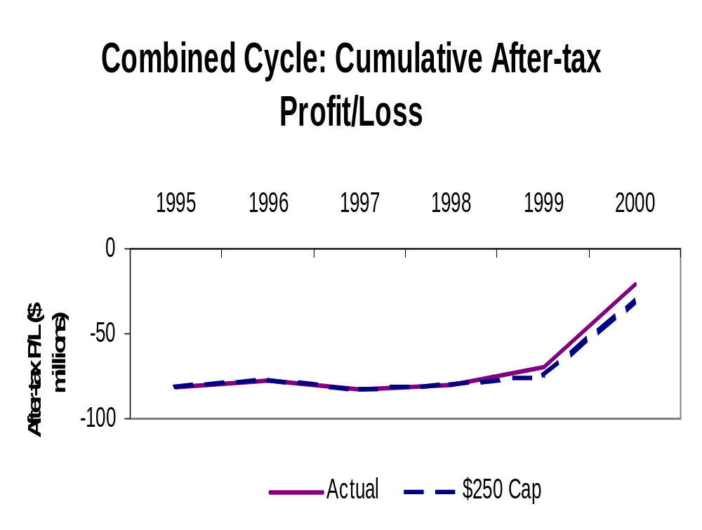
-19-

Slide 24
Load Responsiveness
2700 MW of Load theoretically available under the Interruptible Tariffs
New Load Management Programs Have Been Expensive and Small
  100 MW to 300 MW of Shared Savings with IOU’s When Prices Exceed $250/MWh
  230 MW in CAISO Participating Load Agreement with Capacity Costs of $750/MWh and Energy Costs Up to $750/MWh
  Seldom Used - Most Participants Already Under Interruptible Tariff
Source: ISO DMA August 10 Report
-20-

Slide 25
The ISO’s Demand Side Program Has Not Been Very Effective
The proponents of price caps claim that as soon as the demand side is "workably competitive" then there is no need for price caps
But if ISO sets the caps too low it will not get demand response
The utilities have up to 2700 MW of available interruptible load, yet only a small fraction responds when called (600 MW)
Uncut loads willingly lose value of up to $1,500 per MWh
Thus, during times of scarcity, the value of energy is at least $1,500 per MWh

Slide 26
Price Controls Will Perpetuate Scarcity
Power plants are needed; Demand is still not very price responsive
Operating costs of plants are increasing
  Gas prices high
  Gas generally is on the Margin in WSCC (I.e., Gas-fired generation sets the electricity generating market price)
Power plant economics will keep generators from investing in generation if they anticipate price cap
In state and out of state generation will be incented to sell out of state
-12-

Slide 27
Price Controls are Detrimental to Investment and Other Markets
Merchant generation subject to volatile commodity prices -- caps will inhibit investment
Creates asymmetry between load response and generation
Suppliers will sell outside California where markets are more predictable and prices are higher.
Because of the interdependent linkages in California’s electric market, cannot change one aspect of structure without impacting all others
Uncertainty in the marketplace will dry up the growing forward markets
-22-

Slide 28
Retail Market Design Issues

Slide 29
Retail Issues
SCE and PG&E Customers Receive No Price Signals Due to CTC Balancing Accounts.
SDG&E Customers Entered Volatile Short Term Commodity Markets Without Knowing About Risk and Without SDG&E Hedging For Them.
Limits on IOU Forward Hedging Forces Large Volumes Into Day Ahead and Real Time Markets Which Contributes to Volatility.
CTC Recovery Mechanism Incents IOU’s to Take Large Volumes to Real Time Market.

Slide 30
Lack of IOU Hedging Has Distorted Price Impacts
The IOUs had a choice of buying their power in the PX Block Forward, PX Day Ahead, PX Day Of, and CAISO Ex Post
Hedging limits prevented some purchases of forward energy
IOU claims notwithstanding, there have been significant opportunities to hedge forward prices
  ~ 1800 MW in entire PX block forward for SP15 in June, 2000
  Only ~800 MW for SCE out of 2,200 MW authorized
  Clear market signals to hedge
Fear of prudence review kept IOUs from hedging the risk of day ahead and real time prices

Slide 31
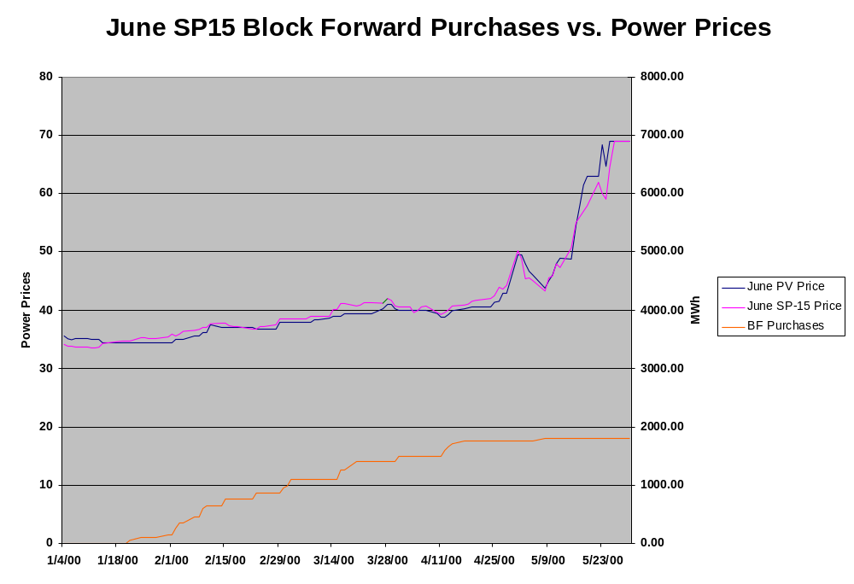
22

Slide 32
Stranded Cost Recovery Incents IOUs to Underschedule in the Forward Market and Buy in the Spot Market
CTC payments can theoretically be increased by underscheduling demand in the PX Day ahead markets
But, underscheduling demand increases ISO prices and reduces reliability
  ~ 30% of ISO load in real time market on 06/14/00
  Only 100 MW of blackouts--a remarkable achievement
13

Slide 33
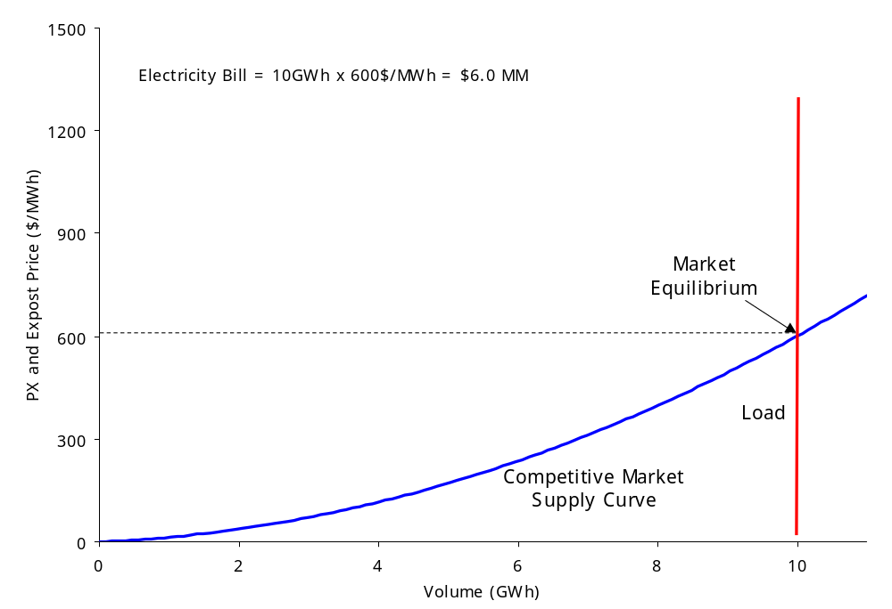
Gross Underscheduling of Load Is a Real Problem
If all power scheduled in PX Day Ahead market, except for small imbalances, market should be in equilibrium: PX DA, PX HA, ISO Ex Post
14

Slide 34
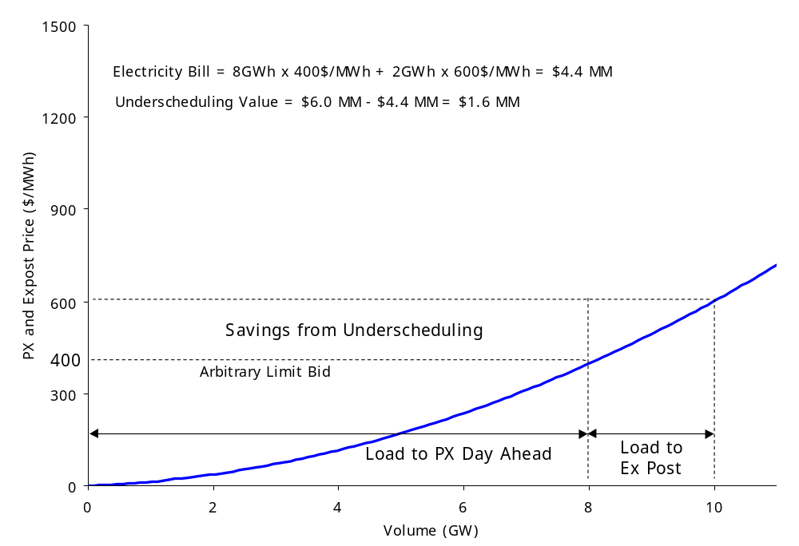
Gross Underscheduling of Load Is a Real Problem
In actual fact, there is an incentive to underschedule, but consequence is pressure on real time reliability as Ex Post load grows.
15

Slide 35
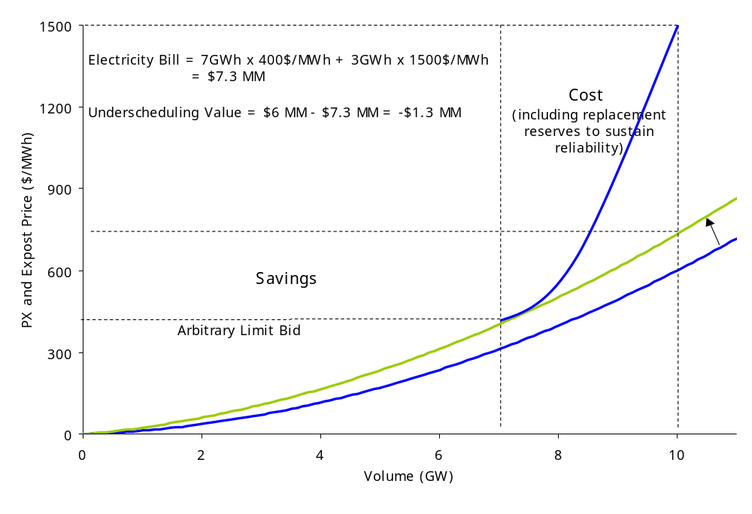
Gross Underscheduling of Load Is a Real Problem
But when there is massive underscheduling in a tight supply market, the ISO may have to take drastic action.
Increasing load
to Ex Post
16

Slide 36
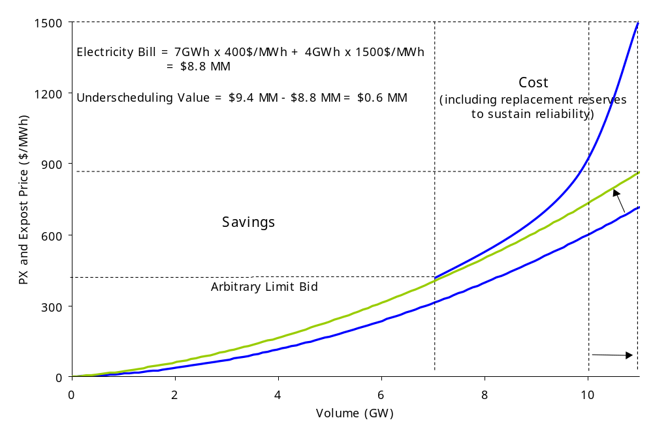
Gross Underscheduling of Load Is a Real Problem
And, when load is growing faster than forecasts, the consequences are amplified.
Increasing load
to Ex Post
17

Slide 37
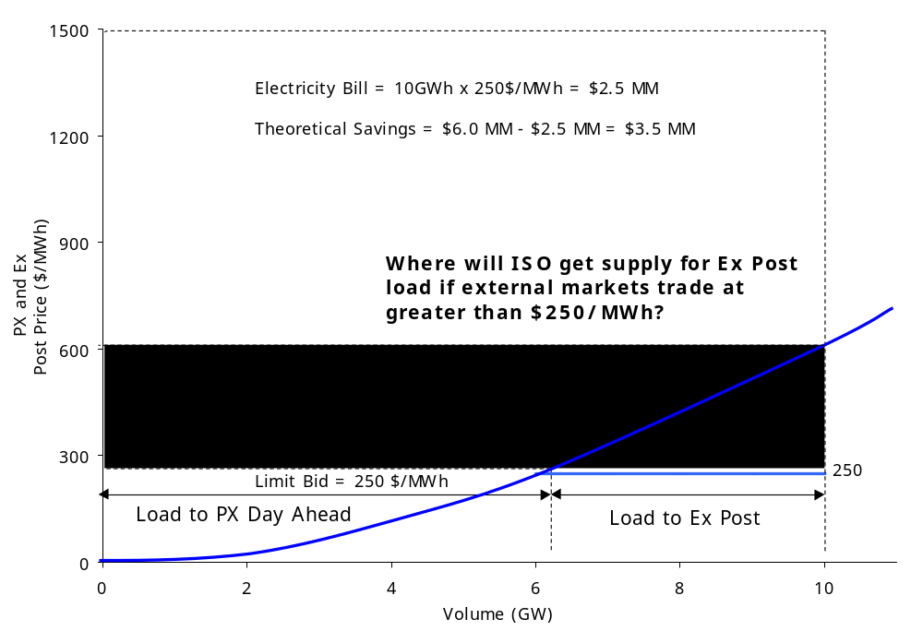
Gross Underscheduling of Load Is a Real Problem
When price caps are reduced to $250/MWh in a scarce supply market, ISO may not be able to maintain reliability due to magnitude of Ex Post load.
18

Slide 38
Underscheduling’s Effects on Reliability Are Observable
Stage 1 Emergency
  In Anticipation of Low Reserves
  Users Asked to Voluntarily Reduce Consumption
  15 Times From May 22 to August 5
Stage 2 Emergency
  Reserves Fall Below 5%
  2700 MW of Interruptible Load Curtailed
  9 Times From May 22 to August 5
Stage 3 Emergency
  Reserves Fall Below 1.5%
  Firm Load Cut - Rolling Blackouts
  0 Times From May 22 to August 5
-12-

Slide 39
Retail Design Flaws Are Largest Contributor to Problem
California should fix its retail problems first.
Should remove barriers to hedging.
Should systematically examine relationship between retail and wholesale market design.
Knee-jerk reactions in wholesale markets will not solve the problem.

Slide 40
Wholesale Market Issues
Analyze whether there are market power concerns associated with times of scarcity and then determine appropriate level of price caps
Publicize market information
Encourage structure/ technological innovation to enhance demand side participation
Don’t mistake San Diego’s failure to hedge as failures in the wholesale market
Decide whether FERC has a role in the underscheduling issue: Are the California utilities exercising monopsony power by underscheduling load into the PX day ahead market?
19

Slide 41
ISO Should Do More Rigorous Market Power Analysis
The Market Analysis Unit report and the UC Energy Institute Report wrongly uses pricing above short term marginal cost to conclude that there is market power
Some market power analysis failed to take into consideration changes in supply and demand like the decrease in hydro generation
To distinguish market power from scarcity, FERC should instruct the ISO to use rigorous analytical measures to determine market power
Under such measures Enron does not have market power

Slide 42
Market Power or Scarcity Rents?
At points of scarcity (e.g., at Stage 2 when you’re getting low on reserves and you’re cutting load) marginal cost is no longer a reasonable price.
Rather when you reach scarcity you should price scarcity rents at the value of energy (e.g., $1,500 as illustrated in the interruptible market)

Slide 43
To Investigate the Source of High Prices FERC Should Review:
High gas prices
Below normal Hydro
Lack of NOx credits
Planned Outages and Forced Outages in June
High demand
Real Capacity Margins in Western Markets
Relationship between Wholesale Market Design and Retail Market Design
Relationship between California Market and Other Western Markets

Slide 44
To Investigate the Source of High Prices FERC Should Review (Continued)
Were any generation plants off-line due to unplanned maintenance during Summer 2000?
Were other Western power markets prices higher (year-on-year)?
What options did SDG&E have to "hedge" its retail rates?
What were prices in the CAL PX block forward market on Jan 15, 2000 and May 15, 2000?
FERC and the ISO should consider the regional impacts of any price caps implemented in California, such as prices not corresponding to flows

Slide 45
We Do Not Have All the Answers. Why?
ISO and PX have a monopoly on data.
ISO and PX have monopoly on analysis of market power.
Transparent markets are preferable to opaque markets. Transparency requires data release.
Open up the books for all to see.

Slide 46
Status of Data Release

Slide 47
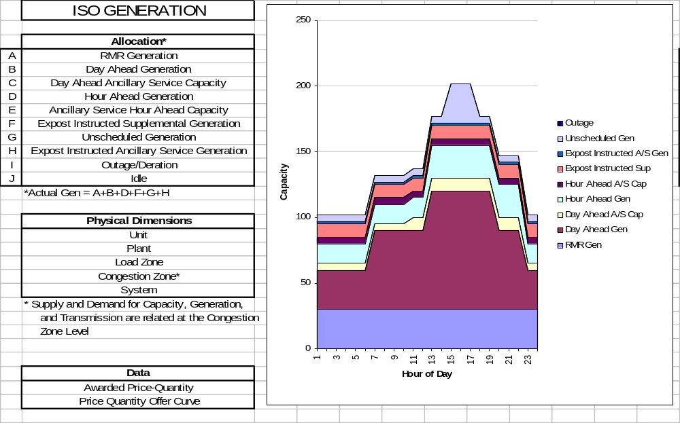

Slide 48
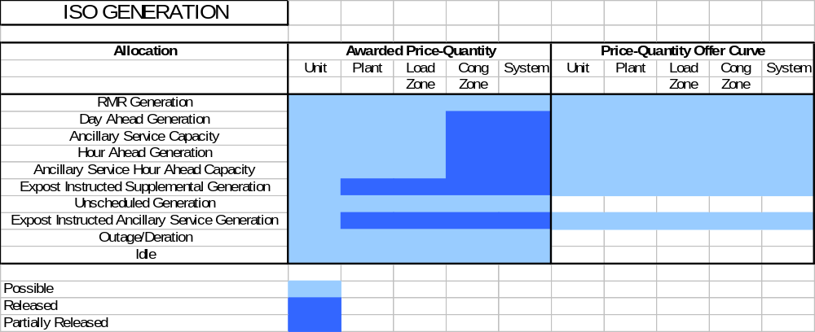

Slide 49
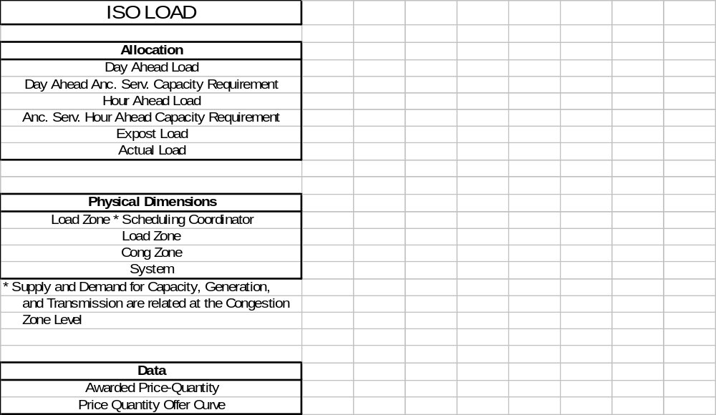

Slide 50
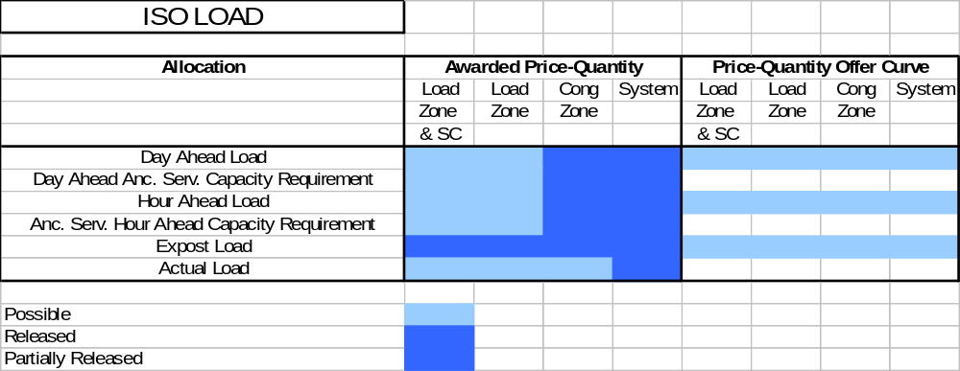

Slide 51
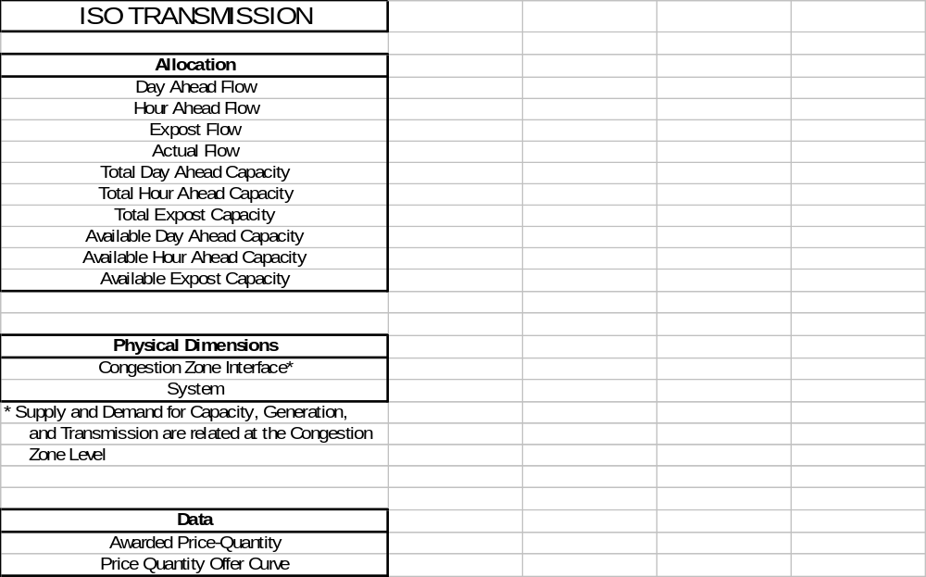

Slide 52
